Slide 1
MCP79410 Hours Alarm Issue
Amond Lin
2024 SEP

Slide 2
Background
Application: Battery Life Calculation
Using MCP79410 hours alarm output function to turn on the VDD power circuit of the external MCU, and only the RTC chip is powered continuity.
Once the MCU is powered up, the MCU will read the ALM0HOUR and then write back with decreasing by 1. And the 23-hour alarm counter of MCU would be increased 1.
So, the MCU would be powered up every 23 hours triggered by MCP79410 RTC alarm output function.
Once 23-hour alarm counter reaches max value (~5 years), it means battery is end of live.

Slide 3
Initialization
RTCSEC=0x00
RTCMIN=0x00
RTCHOUR=0x13
RTCWKDAY=0x0B
RTCDATE=0x22
RTCMTH=0x06
RTCYEAR=0x22
CONTROL=0x10
RTCSEC=0x80
ALM0SEC=0x00
ALM0MIN=0x00
ALM0HOUR=0x00
ALM0WKDAY=0x23
Hour match

Slide 4
Right after production & Normal operation
1st step of their production SOP was to configure RTC based on present date & time and to configure 1st Alarm time with 0:00.
Once the 1st alarm occurred, ALM0HOUR would be read and written back with decreasing 1.
And then so on, the procedure would repeat every 23 hours.

Slide 5
Failure Description
For example with above initial settings,
MCP79410 RTC alarm output function would occur when RTCHOUR counted to 0x21 (ALM0HOUR = 0x21).
At the moment, the MCU would be powered up and read the ALM0HOUR (= 0x21) and then write back with 0x20.
It was expected to get alarm again after 23 hours, but the failure chips would alarm the system just after one hour (RTCHOUR=0x22) and then alarm the system again after 23 hours RTCHOUR=0x20).
There should be only one-time alarm in 23 hours, but there were 2 times recorded.
Additional information:
The failure rate was about 20% so far.
One of failure chip:
Microchip MCP79410-I/ST
Track code.7941
Date: I307 (Y2023, 07W)​
The host MCU: dsPIC33CK128MP206

Slide 6
Failure Analysis (Based on data packet from client)
Design operation
Initialized date/time with present date/time (2022, JUN, 22, Wednesday, 13:00:00)
Configure 1st Alarm time at 0:00.
When ST(RTCSEC bit <7>)=1, RTCC would start working.
When hour-match at 00:00:00, ALM0IF=1, MCU would config ALM0HOUR=0x23 and clear ALM0IF.
When next time with ALM0IF=1, MCU would be powered up to read and write back ALM0HOUR (with decreasing 1) and then clear ALM0IF. And so on, the procedure would be expected with repeating every 23 hours.

Slide 7
Time-line：Design operation
RTCC
2022/6/22
WED
13:00:00
2022/6/23
TUE
00:00:00
2022/6/23
TUE
23:00:00
2022/6/24
FRI
22:00:00
2022/6/25
SAT
21:00:00
Set
00:00:00
Set
23:00:00
Set
22:00:00
Set
21:00:00
Set
20:00:00
Alarm

Slide 8
Failure Analysis (Based on data packet from client)
The problem:
Initialized date/time with present date/time (2022, JUN, 22, Wednesday, 13:00:00)
Configure 1st Alarm time at 0:00.
When ST(RTCSEC bit <7>)=1，RTCC would start working.
When hour-match at 00:00:00，ALM0IF=1.
MCU would config ALM0HOUR=0x23 and clear ALM0IF.
It was expected to get next alarm (let’s call 2nd alarm) after 23 hours, but 2nd aleam would occur again after only 1 hour (RTCHOUR=0x01). MCU didn’t know that, so MCU read and wrote back ALM0HOUR (0x23-1=0x22) again and clear ALM0IF.
3rd alarm would occur properly after 23 hours.
4th alarm would occur after only hour again.
5th alarm would occur properly after 23 hours.
6th alarm would occur after only hour again.
And so so…until MCP79410 was power-down.

Slide 9
Time-line：The problem
Wrong Alarm
Wrong Alarm
Wrong Alarm
RTCC
2022/6/22
WED
13:00:00
2022/6/23
TUE
00:00:00
2022/6/23
TUE
01:00:00
2022/6/23
TUE
22:00:00
2022/6/23
TUE
23:00:00
2022/6/24
FRI
20:00:00
2022/6/24
FRI
21:00:00
2022/6/25
SAT
18:00:00
Set
00:00:00
Set
23:00:00
Set
22:00:00
Set
21:00:00
Set
20:00:00
Set
19:00:00
Set
18:00:00
Set
17:00:00
Alarm

Slide 10
Sept-20, 2024
Reported by Weikeng Amond Lin
All tests were based on Weikeng’s test environment and conditions.

Slide 11
Test process
Initializations:
RTCSEC=0x00
RTCMIN=0x00
RTCHOUR=0x05
RTCWKDAY=0x03
RTCDATE=0x18
RTCMTH=0x09
RTCYEAR=0x24
CONTROL=0x14
ALM0SEC=0x00
ALM0MIN=0x00
ALM0HOUR=0x10
ALM0WKDAY=0x20
RTCSEC=0x80

Slide 12
Test process
dsPIC33CK256MP506 would check MCP79410 one time once MFP pin triggered MCU.
To speed up issue reproduction
0x07H: CRSTRIM = 1
0x08H: OSCTRIM=0xFF
~10mins in real world would be about 23 hours of RTCC.

Slide 13
Data packet (Duplicated on EVM, not from client)
封包 | 名稱 | 起始點 | Start | Address | Write | A-ACK | Data | D-ACK
1 | Bus1(I2C) | 3.89079ms | Start | 6F | Write | A-ACK | 07 | D-ACK
2 | Bus1(I2C) | 4.09025ms | Start | 6F | Read | A-ACK | 14 | D-NACK | Stop | Master NACK
3 | Bus1(I2C) | 6.28412ms | Start | 6F | Write | A-ACK | 0C | D-ACK
4 | Bus1(I2C) | 6.48357ms | Start | 6F | Read | A-ACK | 10 | D-NACK | Stop | Master NACK
5 | Bus1(I2C) | 13.25091ms | Start | 6F | Write | A-ACK | 0C | D-ACK | 09 | D-ACK | Stop
6 | Bus1(I2C) | 14.26477ms | Start | 6F | Write | A-ACK | 0D | D-ACK
7 | Bus1(I2C) | 14.46427ms | Start | 6F | Read | A-ACK | 28 | D-NACK | Stop | Master NACK
8 | Bus1(I2C) | 21.406ms | Start | 6F | Write | A-ACK | 0D | D-ACK | 20 | D-ACK | Stop
9 | Bus1(I2C) | 22.41982ms | Start | 6F | Write | A-ACK | 07 | D-ACK
10 | Bus1(I2C) | 22.61933ms | Start | 6F | Read | A-ACK | 14 | D-NACK | Stop | Master NACK
11 | Bus1(I2C) | 28.95579ms | Start | 6F | Write | A-ACK | 00 | D-ACK
12 | Bus1(I2C) | 29.15526ms | Start | 6F | Read | A-ACK | 83 | D-NACK | Stop | Master NACK
13 | Bus1(I2C) | 29.97238ms | Start | 6F | Write | A-ACK | 01 | D-ACK
14 | Bus1(I2C) | 30.17176ms | Start | 6F | Read | A-ACK | 00 | D-NACK | Stop | Master NACK
15 | Bus1(I2C) | 30.98901ms | Start | 6F | Write | A-ACK | 02 | D-ACK
16 | Bus1(I2C) | 31.18843ms | Start | 6F | Read | A-ACK | 10 | D-NACK | Stop | Master NACK
17 | Bus1(I2C) | 32.0057ms | Start | 6F | Write | A-ACK | 03 | D-ACK
18 | Bus1(I2C) | 32.20512ms | Start | 6F | Read | A-ACK | 23 | D-NACK | Stop | Master NACK
19 | Bus1(I2C) | 33.02315ms | Start | 6F | Write | A-ACK | 04 | D-ACK
20 | Bus1(I2C) | 33.22271ms | Start | 6F | Read | A-ACK | 18 | D-NACK | Stop | Master NACK
21 | Bus1(I2C) | 34.03961ms | Start | 6F | Write | A-ACK | 05 | D-ACK
22 | Bus1(I2C) | 34.23898ms | Start | 6F | Read | A-ACK | 29 | D-NACK | Stop | Master NACK
23 | Bus1(I2C) | 35.05597ms | Start | 6F | Write | A-ACK | 06 | D-ACK
24 | Bus1(I2C) | 35.25542ms | Start | 6F | Read | A-ACK | 24 | D-NACK | Stop | Master NACK
25 | Bus1(I2C) | 44.00665ms | Start | 6F | Write | A-ACK | 0C | D-ACK
26 | Bus1(I2C) | 44.20609ms | Start | 6F | Read | A-ACK | 09 | D-NACK | Stop | Master NACK
27 | Bus1(I2C) | 46.48592ms | Start | 6F | Write | A-ACK | 0D | D-ACK
28 | Bus1(I2C) | 46.68535ms | Start | 6F | Read | A-ACK | 20 | D-NACK | Stop | Master NACK

Slide 14
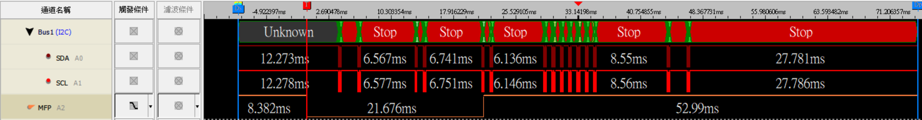
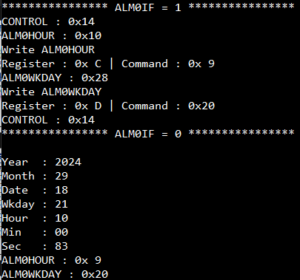
Read/Write with UART print info
1
2
3
4
5
6
7
8
9
1
2
3
4
5
6
7
8
9

Slide 15
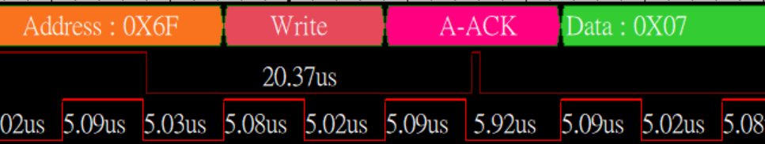
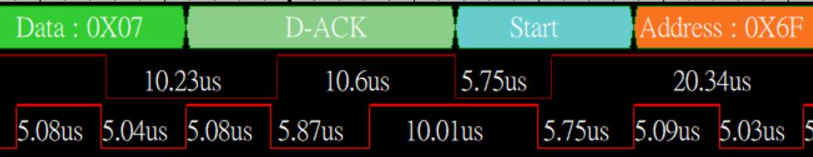
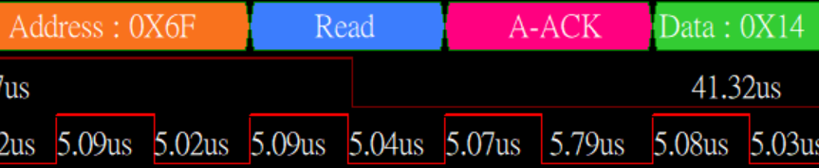
Data packet timing

Slide 16
Sept-22, 2024
Reported by Weikeng Amond Lin
All tests were based on Weikeng’s test environment and conditions.

Slide 17
Typo – Update p.12
P.12
0x07H: CRSTRIM = 1
0x08H: OSCTRIM=0xFF

Slide 18
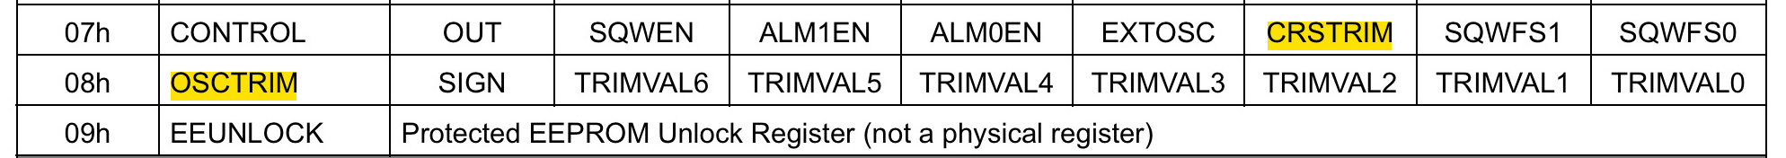
Additional Feedback from client
MCU would config CRSTRIM = 0 by byte-writing during initialization.
OSCTRIM was never configured by MCU during/after initialization.

Slide 19
Additional Feedback from client
I2C speed: 100K with 3.3V Vdd
I2C AC CHARACTERISTICS
Measured Tr = 450ns

Slide 20
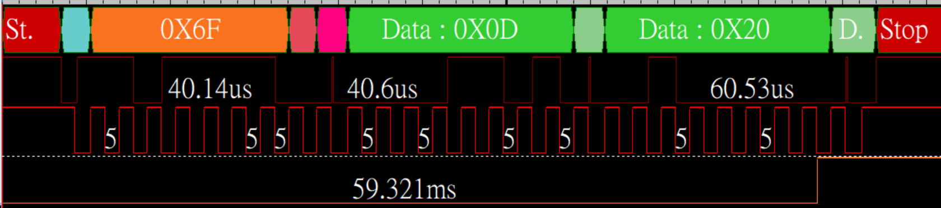
Question from Weikeng to client
Q: Once ALM0IF was cleared, MFP would be pull-high immediately. Was the last frame sent completely before MCU was off?
Ans:
Client will compare the last frame timing with MFP pin.

Slide 21
Sept-23, 2024
Reported by Weikeng Amond Lin
All tests were based on Weikeng’s test environment and conditions.

Slide 22
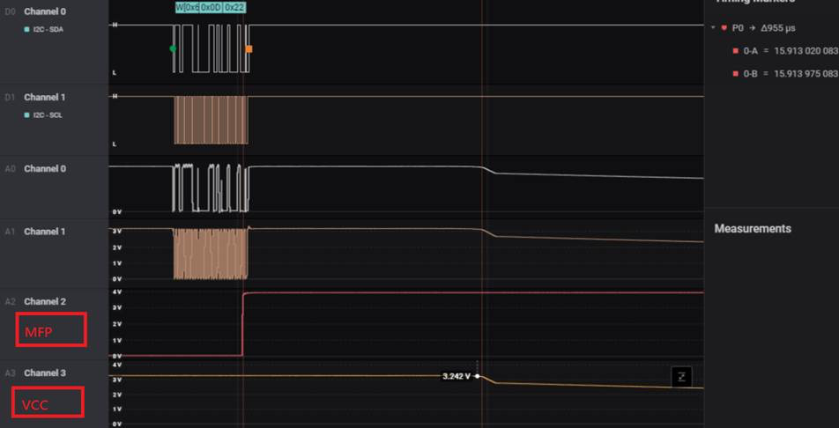
Timing sequence from client (1/3)
VCC would start falling down after 955ns with MFP pull-high.

Slide 23
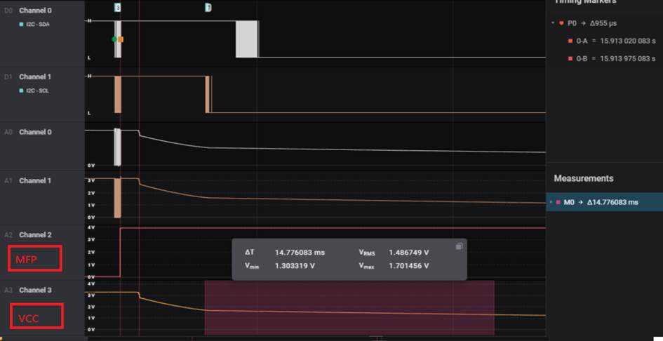
Timing sequence from client (2/3)
When VCC was powered down (RTC got to sleep), VCC down from 1.7V to 1.3V would take about 14ms to compare with T15 on data sheet.

Slide 24
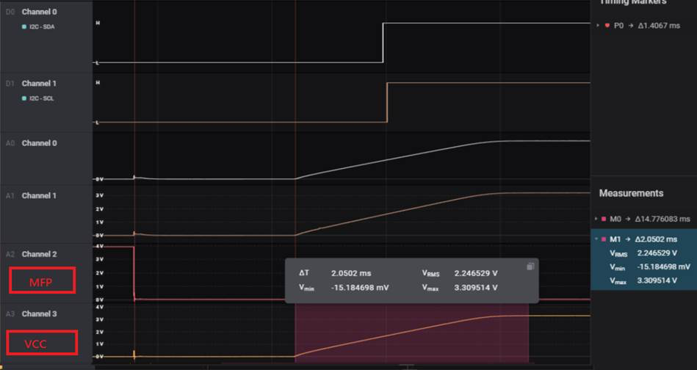
Timing sequence from client (3/3)
When RTCC waked up, MFP was low. Right after 14ms, VCC started going up from 0~3.3V to compare with T16 on datasheet.

Slide 25
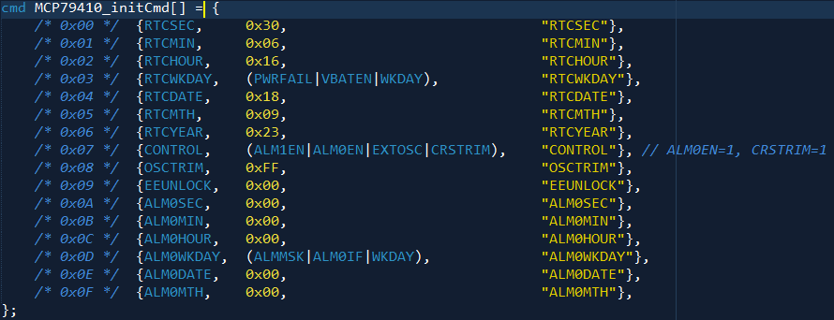
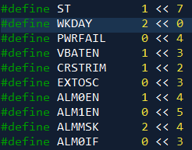
Test process
Initializations:

Slide 26
Test process 2
Calibration process
repeat read those register 14 times
ALM0WKDAY, RTCWKDAY, RTCSEC, RTCMIN, RTCHOUR, RTCDATE, RTCMTH, RTCYEAR, CONTROL, ALM0HOUR, ALM0MIN, ALM0SEC
Initial the following register in order
RTCSEC=0x30, ALM0WKDAY=0x22, ALM0SEC=0x00, ALM0MIN=0x00, ALM0HOUR=0x00, CONTROL=0x14, OSCTRIM=0xFF, RTCYEAR=0x23, RTCMTH=0x09, RTCDATE=0x18, RTCHOUR=0x16, RTCMIN=0x06, RTCWKDAY=0x0A, RTCSEC=0xB0
Power on sequence
We programed the MCU and then disconnected the USB cable. Once VDD of the MCU and RTCC dropped to zero, the USB cable was connected again to check the initial flow.

Slide 27
Calibration Flowchart
MCU
Initial
Read RTCC
Write
RTCWKDAY=0x29
Read RTCC
count=8
N
count=13
Y
N
Write ALM0HOUR -= 1
ALM0IF = 0
Wait Alarm
Y
Y
ALM0IF=1
N
Read ALM0HOUR
Initial RTCC

Slide 28
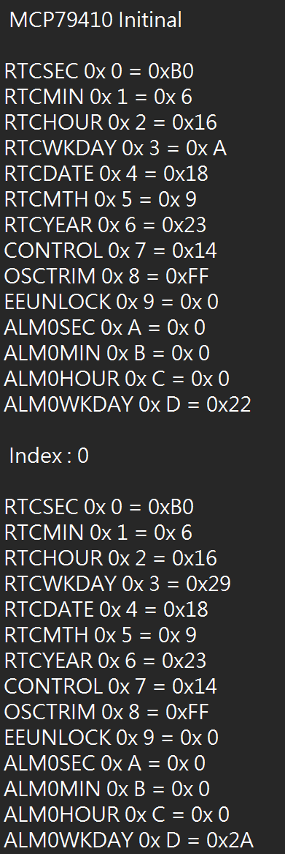
Need to check
After RTCC initial and set ST bit(RTCSEC<Bit 7>)
RTCWKDAY = 0x0A
Upon reading the RTCC for the second time, we wrote RTCWKDAY=0x29 and found that ALM0IF had been set.
Only read for check PWRFAIL and write back, not modify value.

Slide 29
Sept-24, 2024
Reported by Weikeng Amond Lin
All tests were based on Weikeng’s test environment and conditions.

Slide 30
Calibration Flowchart：Modified to match actual process
MCU
Initial
Read RTCC
Read and write back
RTCWKDAY
Read RTCC
count=8
N
Y
Write ALM0HOUR -= 1
ALM0IF = 0
Wait Alarm
count=13
N
ALM0IF=1
Read ALM0HOUR
N
Y
Y
Y
N
Reset count >= 4
MCU
Reset
Initial RTCC

Slide 31
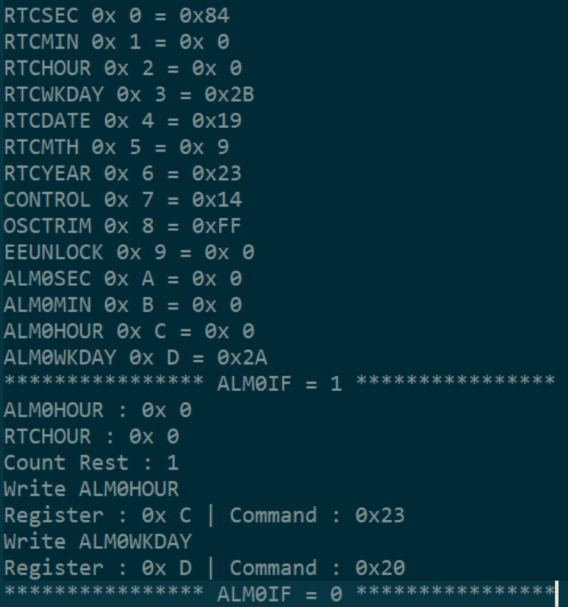
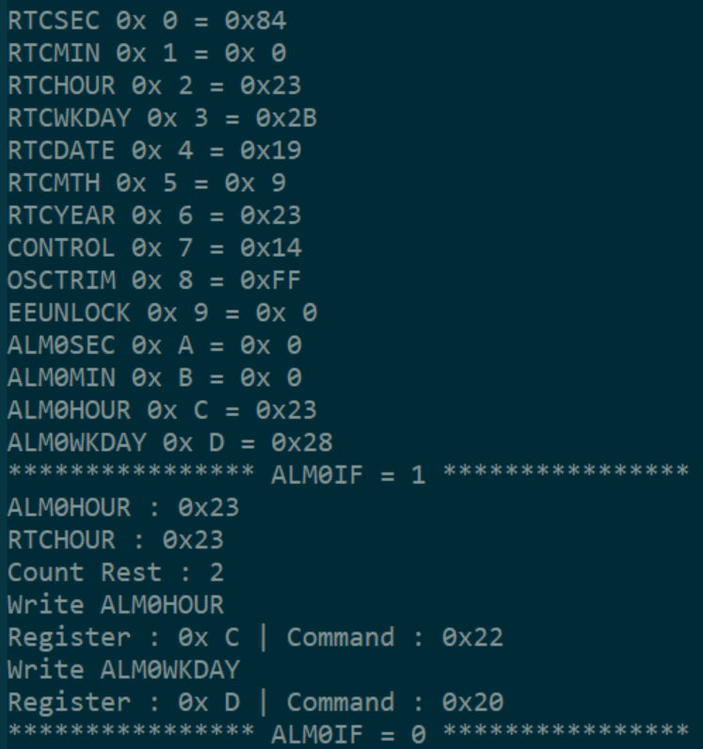
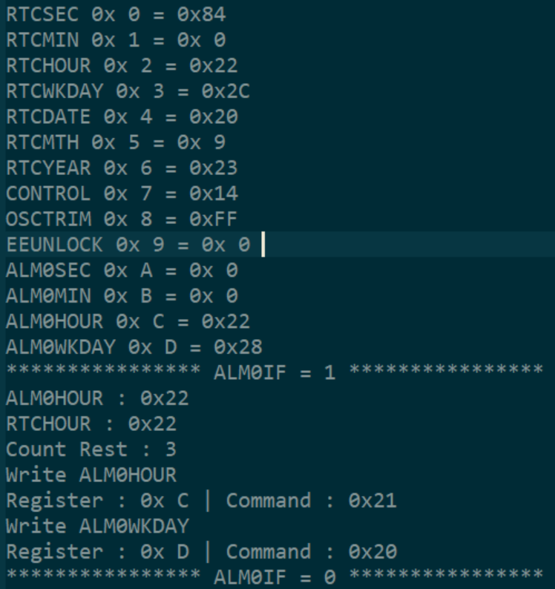
Teraterm Log

Slide 32
Question from Weikeng to client
With the failure chip on power unit, can we see the same situation after initializing the RTCC?

Slide 33
Sept-25, 2024
Reported by Weikeng Amond Lin
All tests were based on Weikeng’s test environment and conditions.

Slide 34
Production process with RTCC, without MCU.
Main Board
with RTCC
Main Board
with RTCC
Main Board
with RTCC
VCC
RTCC
RTCC
RTCC
Battery
VBAT
Battery
VBAT
Battery
VBAT
test fixture
Production Steps
Step1. Battery assembly
Step2. Charging Station
Step3. RTCC Calibration Process

Slide 35
Final test process with RTCC & MCU.
*RTCC was never power-off.
Main Board
with RTCC
Main Board
with RTCC
Main Board
with RTCC
VCC
RTCC
RTCC
RTCC
Battery
VBAT
Battery
VBAT
Battery
VBAT
test fixture
Production Steps
Step1. Battery assembly
Step2. Charging Station
Step3. RTCC Calibration Process
Main Board
with RTCC
Main Board
with RTCC
Read &
write back
MCU
Execute
calibration
MCU
RTCC
VBAT
VCC
RTCC
VBAT
VCC
Battery
Battery
If no **issue was detected for 3 times (MFP=1 for 3 tims), MCU would do 1 time RTCC calibration and then back to hour-alarm mode.
Final test Process
(Normally)
什麼意思?
Once MFP=1
**Issus means RTCHOUR != ALM0HOUR was detected but MFP=1.
RTCC Calibration Process

Slide 36
Final test process with RTCC & MCU.
*RTCC was never power-off.
Main Board
with RTCC
Main Board
with RTCC
Main Board
with RTCC
VCC
RTCC
RTCC
RTCC
Battery
VBAT
Battery
VBAT
Battery
VBAT
test fixture
Production Steps
Step1. Battery assembly
Step2. Charging Station
Step3. RTCC Calibration Process
Main Board
with RTCC
Main Board
with RTCC
Read &
write back
MCU
Execute
calibration
MCU
RTCC
VBAT
VCC
RTCC
VBAT
VCC
Battery
Battery
If **issue was detected, MCU would not do RTCC calibration and keep in hour-alarm mode.
Final test Process
(with **issue)
Once MFP=1
**Issus means RTCHOUR != ALM0HOUR was detected but MFP=1.
RTCC Calibration Process

Slide 37
Question from BU to field
Question: If a chip fails as per the PPT (some even-numbered hours fail in 24 Hour mode), can a failed hour be repeated immediately? That is, if the fail at hour 22:00 is repeated again, does it fail again?
Ans: Before RTCC is power-off, the issue would continue repeating and never stop. 22:00 was just one of examples. It could be any other hour. Additional update:
RTCC was always powered by battery and was never power-off.
The issue can be only reproduced with two conditions so far as we known:
Reproducible ONLY on client’s product main board. (we have not been able to reproduce the issue on EVM.)
The failure chip can NOT be re-initialized again after “Production Steps”. Re-initialization means the step3 of production steps. If did that again, the issue would not happen …at least we didn’t see the issue again with the same failure chip and unit.

Slide 38
Question from BU to field
Question: Need to get some failed units to help confirm this issue.?
Ans: Most failure units are still in factory. Will check with client for the failure units. On the other hands, Weikeng Amond has 1 failure chip but has not been able to reproduce the issue on our EVM.

Slide 39
Question from BU to field
Question: Need to get some failed units to help confirm this issue.?
Ans: Most failure units are still in factory. Will check with client for the failure units. On the other hands, Weikeng Amond has 1 failure chip but has not been able to reproduce the issue on our EVM.

Slide 40
Suggestion from BU & Microchip Taiwan
Depending on how the power is applied, this might be a problem. If the VBAT supply is applied first, then the VDD, then the registers may not initialize in the POR state. This means that some registers, like the CALIBRATION byte may not be as expected. This would likely vary from part to part.
It is concerned about using the course TRIM setting to accelerate the testing. I don't know if that would be valid for testing alarms as we know there is already an errata regarding the TRIM value with the Minute alarm, so we will try to see if another method works better.
Feedback from field: It is true that we have not able to reproduce the issue with TRIM setting. We are not sure that accelerating the testing with TRIM setting is okay or not.
It might be helpful if client can read TRIM back when the issue was happing?

Slide 41
Sept-26, 2024
Reported by Weikeng Amond Lin
All tests were based on Weikeng’s test environment and conditions.

Slide 42
Question or Analysis from BU to field
The battery is applied first and it is charged. What is this, a rechargeable Lithium cell, or a SuperCap?
Ans: This project is using rechargeable Lithium cell.
What is the charge voltage (slide 34)?
Ans:
We know that when the battery voltage is applied before VDD, that the registers do not have a known state. Until the VBATEN bit is turned on, there is no way that the device will store the registers correctly under battery power.
Ans: Before calibration process, the registers do not have a known state. Step.3 (slide 34) is for this and making sure VBATEN = 1 (process on slide 30)?
The VDD looks like 3.3V per slide 19, also the I2C speed is 100kHz, which should be fine. I2C errors tend to be all or none, that is, if too fast it doesn't work at all but below that speed it always works. This can be variable when software I2C or bit-banging is used as it may not have a consistent timing like a hardware I2C port.

Slide 43
Question or Analysis from BU to field
Slide 22, the VDD falling after MFP going high is OK, slide 23 VDD fall rate is fine, not too fast or too slow, exponential decay is typical for many systems. How long until the power is restored and what does the VDD reach just before it is turned on? Does it really reach 0V?
Ans: Basically, MFP would be high for 23 hours until next hour-alarm event. So, VDD would have enough time to reach 0V.
MFP would be high for at least 1 hours with issue. VDD still has enough time to reach 0V
Slide 24, VDD is powered on and MFP is low. Is this what is expected? If the MFP was high on power down, shouldn't it be high on power up? What changed here to explain this?
Is the RTCC getting confused, such as if the VBATEN bit is not set? Slide 25 right side seems to show that VBATEN = 1, is this correct? If the bit is set, battery is applied and VDD falls and rises, then the MFP should be the same. Only the PowerFail bit should change and time should change.
Ans: The VDD circuit would be enabled by MFP with active-low. But it is true that MFP could be possibly high by pull-up resistor before initializing RTCC. After RTCC was initializd, MFP would be certain with active-low and normal high two mode. When MFP = high, power source of RTCC will be from battery.
I want to clarify that the Course Trim function was never intended to be a normal operational mode, so it might be good to do testing of the alarms without it, perhaps by setting the time to within a few seconds before the alarm is expected. That would be something I would do if I had a unit that failed under the Course Trim

Slide 44
Additional Feedback from client
Read OSCTRIM (Never be initialized)
Unit # | Unit Status | Test with Source code # | OSCTRIM
SN001 | Pass | V0905 | 144
SN005 | Failure | V0905 | 73
SN006 | Failure | V0905 | 87
SN007 | Failure | V0905 | 80
SN008 | Failure | V0905 | 7
SN009 | Failure | V0905 | 34

Slide 45
Oct-1, 2024
Reported by Weikeng Amond Lin
All tests were based on Weikeng’s test environment and conditions.

Slide 46
Confirm testing process
Calibration flowchart check OK (slide 30).
We check the Weikeng test code from polling RTCC and initial, there are match AcBel calibration flowchart.
The power-up sequence is VCC after VBAT check OK.
On AcBel production line, during assembly, VBAT is powered first, and VCC only receives power when it reaches the charging station.
Following the power sequence, the Weikeng test platform reads the OSCTRIM register as 0x00, while the AcBel test platform reads the OSCTRIM register as either 0x00 or 0xFF. It is uncertain whether this difference has any impact.

Slide 47
Next Action
Remove VCC, VBAT and follow power sequence.
According to the power sequence, AcBel can observe that the OSCTRIM register is either 0x00 or 0xFF. Therefore, during initialization, if a value of 0xFF or any other value is read from OSCTRIM, it will be written to 0x00. This process will be used to test whether the issue can be reproduced.
Weikeng will implement a new testing method
Set an alarm to occur after one hour, then set another alarm to occur after 23 hours. The purpose of this is to observe the same situation on the Weikeng test platform as seen on the AcBel platform.

Slide 48
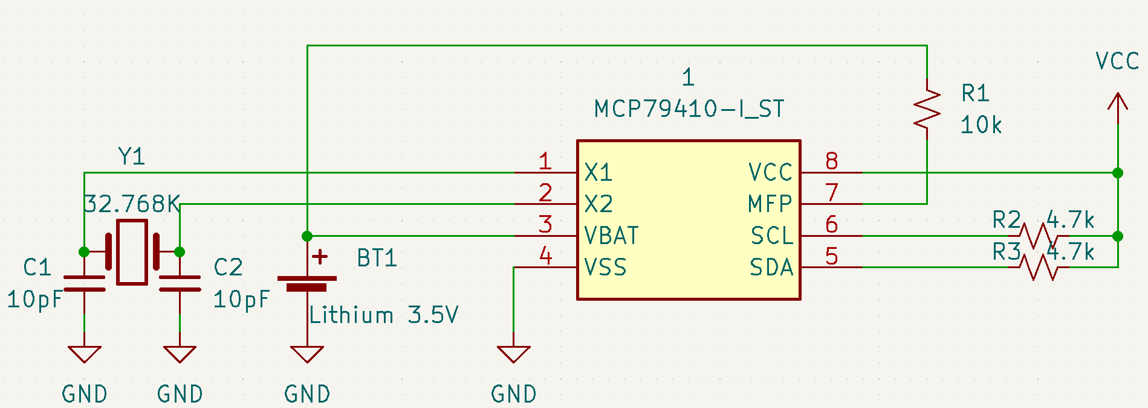
Weikeng test platform circuit

Slide 49
Oct-2, 2024
Reported by Weikeng Amond Lin
All tests were based on Weikeng’s test environment and conditions.

Slide 50
測試重現條件
上電過程先vbat，後vcc
初始化過程，在polling過程中讀回OSCTRIM確認為0，並且設定RTCHOUR=0x16，ALM0HOUR=0x17。
完成後，在一個小時內，重新設定OSCTRIM=0x07。
當RTCHOUR=0x17發生ALM0IF=1，此時將ALM0HOUR=0x00。
可重現問題

Slide 51
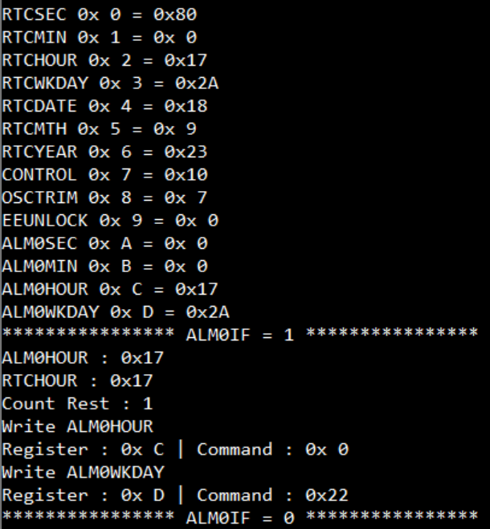
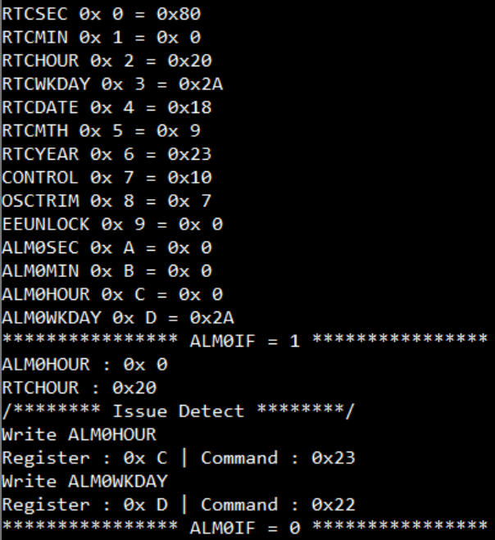
Alarm紀錄點
初始化後1小時發生alarm，列印暫存器資料，將ALM0HOUR=0x00
RTCHOUR=0x20發生ALM0IF=1，與ALM0HOUR設定不相同

Slide 52
Thanks.

Slide 53
RTCC assemble and Test process
Main Board
with RTCC
Main Board
with RTCC
Main Board
with RTCC
RTCC
RTCC
RTCC
Battery
VBAT
Battery
VBAT
Battery
VBAT
VCC
Production Line
test fixture
Battery assembly
Charging Station
Calibration Process
Main Board
with RTCC
Main Board
with RTCC
Read and write back
MCU
when RTCHOUR != ALM0HOUR
determined to be a failed
run calibration
MCU
RTCC
VBAT
VCC
RTCC
VBAT
VCC
Battery
x3 times
Battery
Test Process
MFP=1
Calibration Process

